Slide 1
User Training: Can it be Fun? YES.
Explore Self-Learn and Applied Learning Delivery Methods with Us
PRESENTED BY
Robert S. Scata and Carla A. Iezzi
State of Connecticut Department of Emergency Services and Public Protection
Division of Emergency Management and Homeland Security
ORCHESTRATE
Juvare Users Conference 2025

Slide 2
User Training: Can it be Fun? YES.
Explore Self-Learn and Applied Learning Delivery Methods with Us
PRESENTED BY
Robert S. Scata and Carla A. Iezzi
State of Connecticut Department of Emergency Services and Public Protection
Division of Emergency Management and Homeland Security
ORCHESTRATE
Juvare Users Conference 2025

Slide 3
New Year, New You
Carla
Bob
RESOLVE TO Train More
this Year!

Slide 4
Disclaimer
HOWEVER,
there is real value to:
hearing it out loud
digesting it, and
revisiting within your organization
Likely nothing
presented from us today will be Earth Shattering

Slide 5
Teaching a Diverse Group
Our customers for training…
169 municipalities
two tribal nations
state agencies
as well as a myriad of health, education, utility, federal partners, and volunteer/aid organizations

Slide 6
BEST PRACTICE #1
Entertain Them or Else
WARNING: On its own, a training course
is not remotely exciting and may be hazardous to the health of the Participant and/or Trainer.
UNLESS you do your best to entertain the audience

Slide 7
BEST PRACTICE #2
Team Spirit
Instructors MUST…
Qualify for stand-up comedy
Be passionate about the topic
Believe in the product
Have field experience
Know the audience
Appreciate the work being done Recognize the challenges being faced
Understand system intricacies
Serve them up
a big pitcher!

Slide 8
BEST PRACTICE #3
Offer Healthy Options
Be Accommodating
Schedules
Day/night/weekend shifts Full and part time workers Volunteers Just in time needs
Learning Preferences
Instructor led classroom Written materials Streamed content
Technology Differences
Variety
is the
Spice of Life

Slide 9
BEST PRACTICE #3
Offer Healthy Options
Self-Learn Training Housed in WebEOC
Desk references - stepped guides Training videos - for the trickier topics
(Virtual) Classroom
Basic Course - Foundational Items, Navigation, Tips/Tricks Followed by Interactive Courses End with a Mini Exercise to “Putting It All Together”
Supplement with Virtual Office Hours / Support

Slide 10
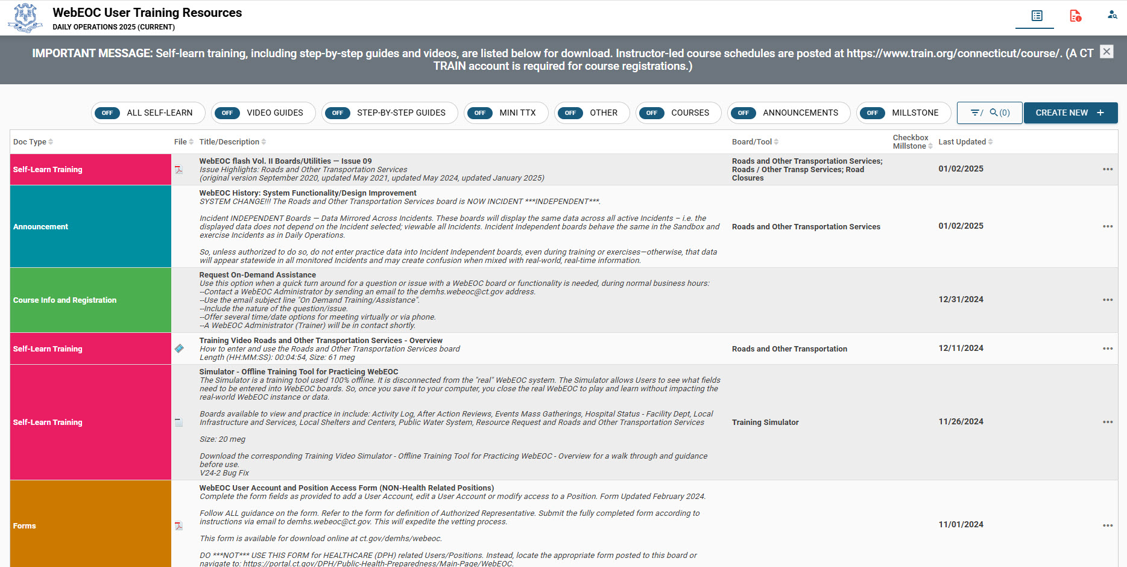
Example: Training Resource Library – Make it Easy Access

Slide 11
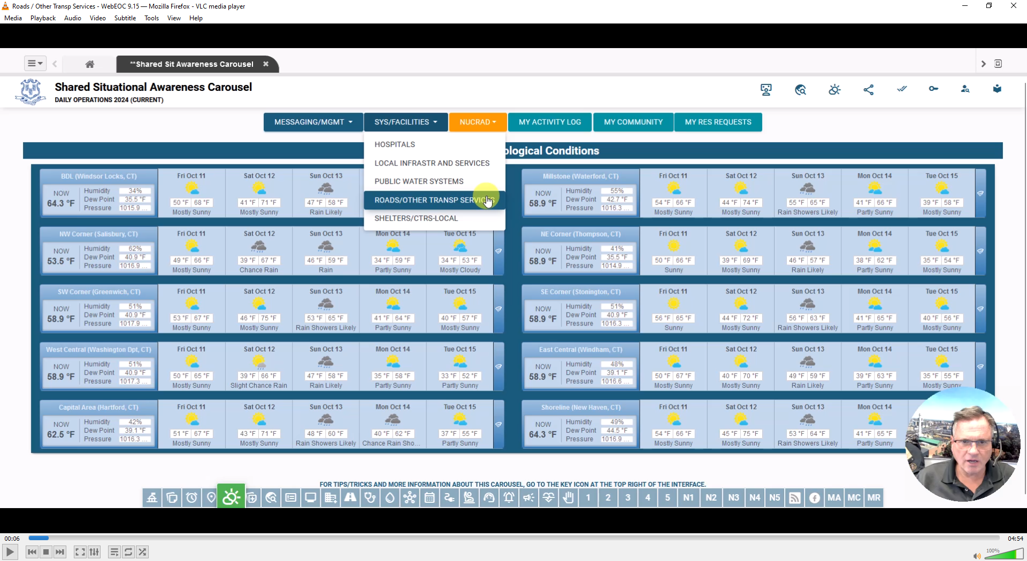
Example: Training Videos – HH:MM:SS, Size:##megs

Slide 12
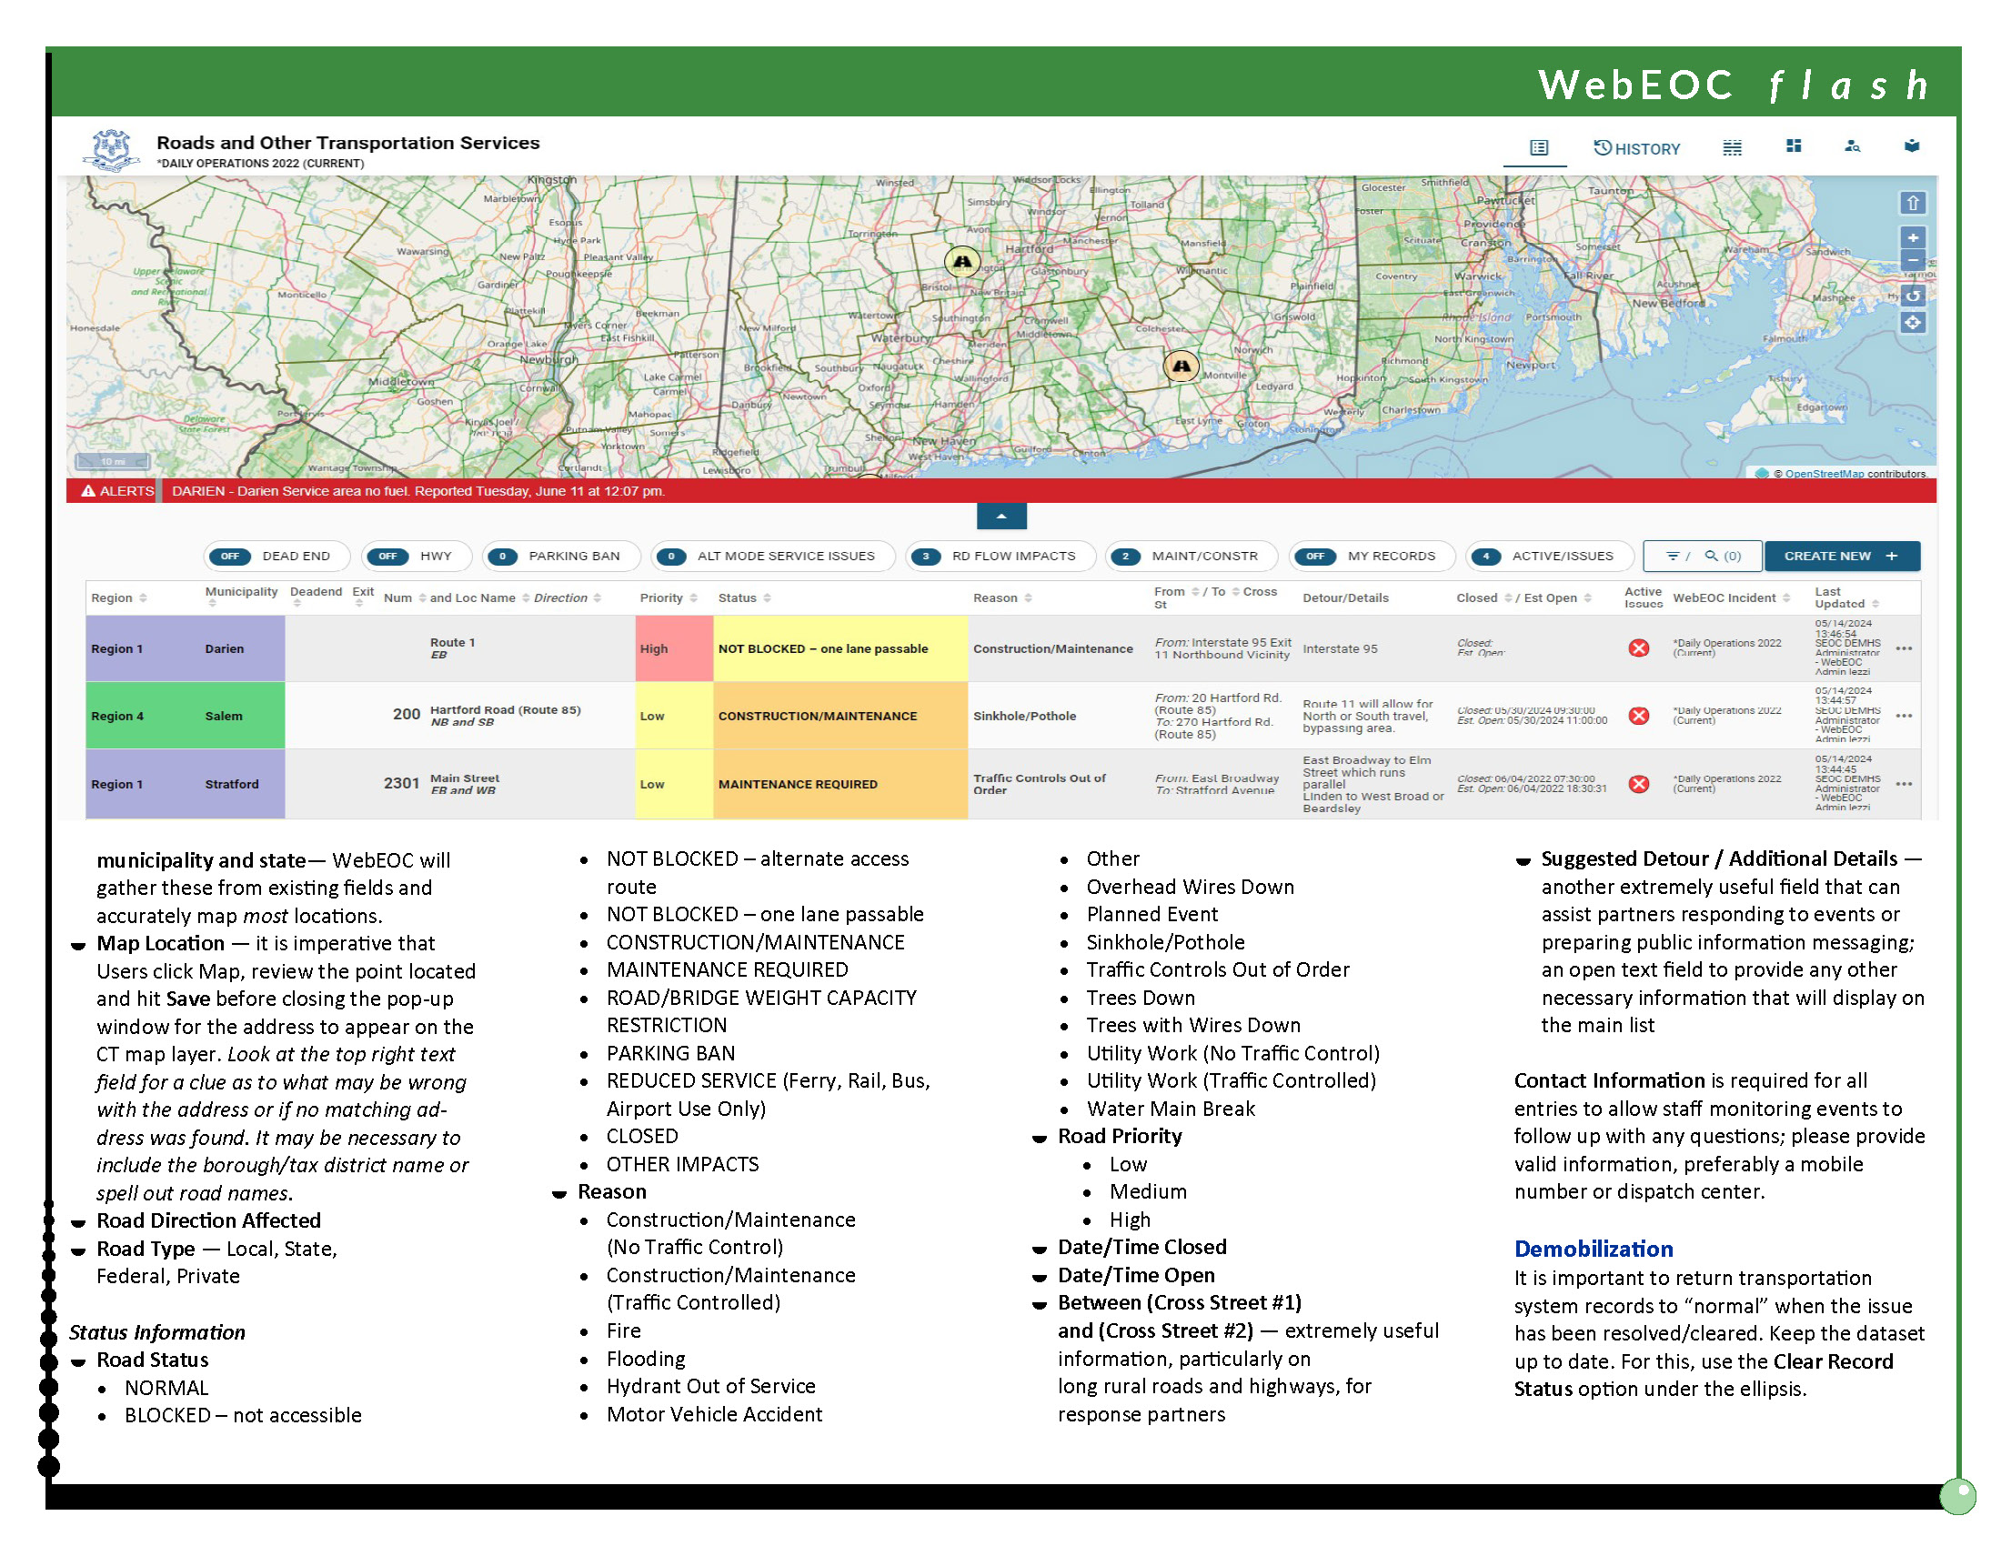
Example: Desk References - WebEOC flash Articles
Vol. I System Overview
Vol. II Boards/Utilities
Vol. III SEOC Specific
Vol. IV NucRad Specific

Slide 13
BEST PRACTICE #4
Class Rules
Registration required
Pre-Requisites/Expectations spelled out in course description
Commitment to actively participate during entire class session Basic computer skills Understanding of internet browsers Microphone functioning Camera functioning and ON entire class
Vetted Credentials
Virtual Platform – NOT Recorded
NO Exceptions

Slide 14
BEST PRACTICE #5
Community Reach
Get the Word Out
Distribution Lists
Social Media
Mandates from Management
Ask Partners to Share Out
Post/Announce Everywhere You Can
Registration/Access to Training Must Be Easy
Training
Today!
Getting Them
There
May Be the
Hardest Part

Slide 15
Questions
and, while we take questions… here is a shameless plug for the WebEOC Administrators’ Group
Google Group Help Forum
Monthly Webinars
Weekly Geek Sessions
Google Docs Library
Join WAG!

Slide 16
Thank You
Candids - Bob and Carla
Traveling Together
Thanks for the opportunity! Happy to see you all here.
Happy New Year. And, Happy Training!

Slide 17
Reach Out

